Slide 1
Cortex-M0+ CPU Core

Slide 2
Overview
Cortex-M0+ Processor Core Registers
Memory System and Addressing
Thumb Instruction Set
References
DDI0419C Architecture ARMv6-M Reference Manual

Slide 3
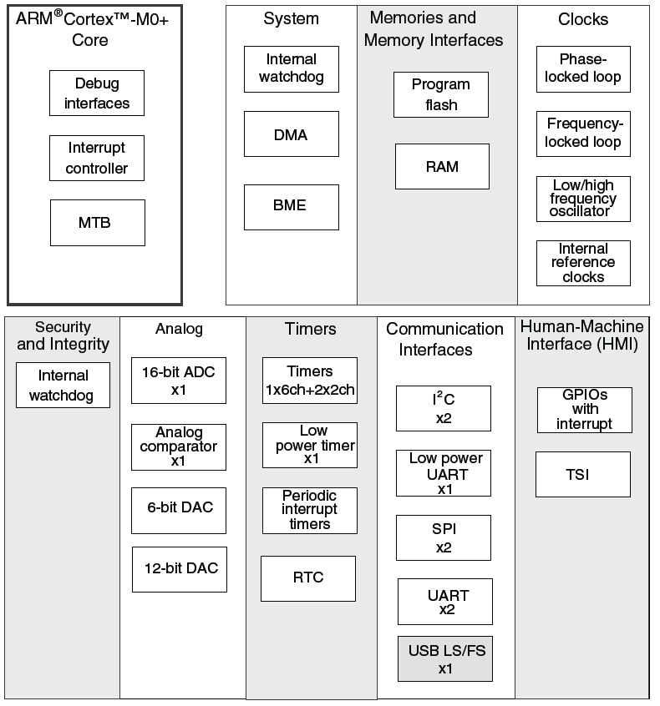
Microcontroller vs. Microprocessor
Both have a CPU core to execute instructions
Microcontroller has peripherals for embedded interfacing and control
Analog
Non-logic level signals
Timing
Clock generators
Communications
point to point
network
Reliability and safety

Slide 4
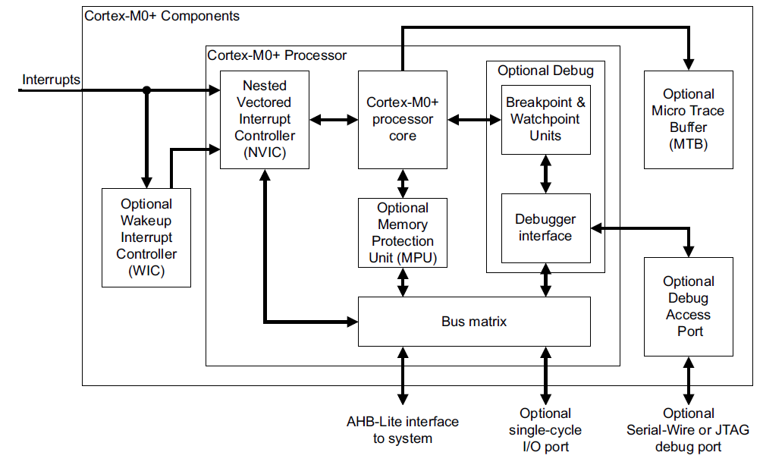
Cortex-M0+ Core
Notes:
The Cortex-M0+ core contains many components. At the center of the Cortex-M0+ Processor is the processor core, which communicates with memory to get instructions and access data. Memory is not shown on this diagram, but is connected via the AHB-Lite interface. The bus matrix shares the memory bus among multiple possible readers and writers. An optional memory protection unit enables the system to restrict a task to using only a limited region of memory, limiting the effects of bugs. Interrupts come to the processor core through the Nested Vectored Interrupt Controller (NVIC), which prioritizes and filters them as needed. The optional Wakeup Interrupt Controller cuts power consumption by letting the NVIC and the rest of the processor go to a low-power sleep mode and waking them up if an interrupt is requested. Several modules provide debug support, including downloading code to the MCU’s memory, setting breakpoints to control program execution, and tracing the sequence of instructions actually executed.

Slide 5
Architectures and Memory Speed
Load/Store Architecture
Developed to simplify CPU design and improve performance
Memory wall: CPUs keep getting faster than memory
Memory accesses slow down CPU, limit compiler optimizations
Change instruction set to make most instructions independent of memory
Data processing instructions can access registers only
Load data into the registers
Process the data
Store results back into memory
More effective when more registers are available
Register/Memory Architecture
Data processing instructions can access memory or registers
Memory wall is not very high at lower CPU speeds (e.g. under 50 MHz)

Slide 6
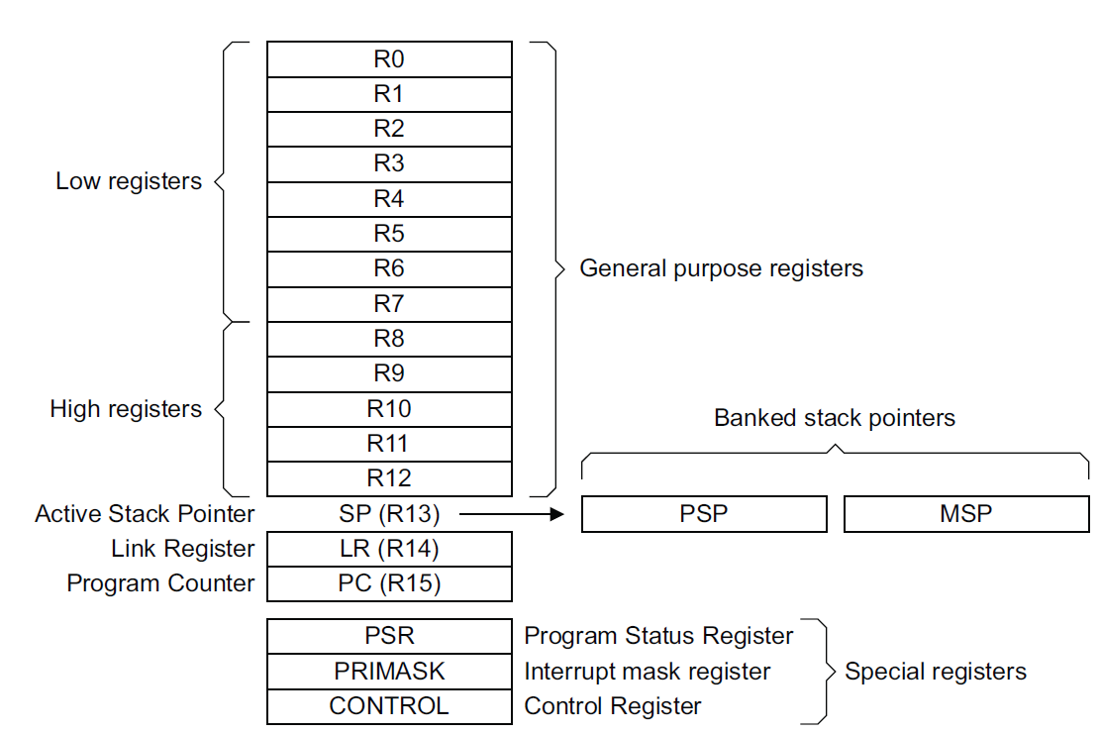
ARM Processor Core Registers
R0-R12 - General purpose, for data processing
SP - Stack pointer (R13)
Can refer to one of two SPs
Main Stack Pointer (MSP)
Process Stack Pointer (PSP)
Uses MSP initially, and in Handler mode
In Thread mode, can select either MSP or PSP using SPSEL flag in CONTROL register.
LR - Link Register (R14)
Holds return address when called with Branch & Link instruction (B&L)
PC - program counter (R15)
Notes:
The ARM programmer’s model (or Instruction Set Architecture) features multiple 32-bit registers. Some of them are for general use, while others are specialized.

Slide 7
Operating Modes
Reset
Thread
Mode. MSP or PSP.
Exception Processing
Completed
Starting Exception Processing
Handler Mode
MSP
Which SP is active depends on operating mode, and SPSEL (CONTROL register bit 1)
SPSEL == 0: MSP
SPSEL == 1: PSP
Notes:
The processor can operate in one of two modes, based on whether it is performing exception processing. This also determines which stack pointer the term “SP” (R13) refers to: either the PSP or the MSP.

Slide 8
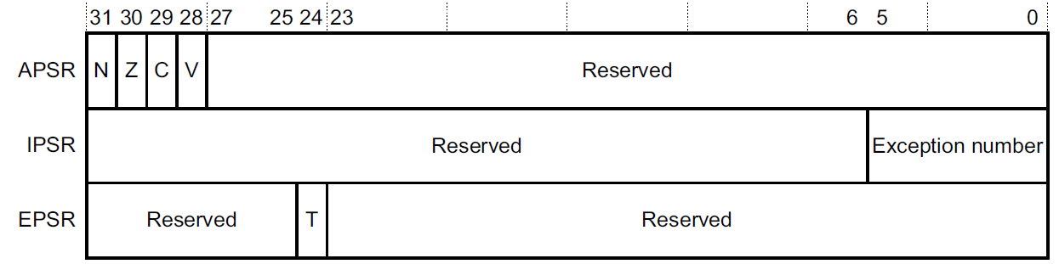
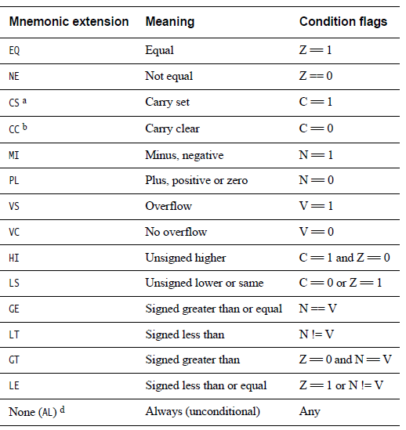
ARM Program Status Register
Three views of same register
Application PSR (APSR)
Condition code flag bits Negative, Zero, oVerflow, Carry used for conditional branches, extended precision math, error detection
Interrupt PSR (IPSR)
Holds exception number of currently executing ISR
Execution PSR (EPSR)
Thumb state

Slide 9
ARM Processor Core Registers
PRIMASK - Exception mask register
Bit 0: PM Flag
Set to 1 to prevent activation of all exceptions with configurable priority
Access using CPS, MSR and MRS instructions
Use to prevent data race conditions with code needing atomicity
CONTROL
Bit 1: SPSEL flag
Selects SP when in thread mode: MSP (0) or PSP (1)
Bit 0: nPRIV flag
Defines whether thread mode is privileged (0) or unprivileged (1)
With OS environment,
Threads use PSP
OS and exception handlers (ISRs) use MSP

Slide 10
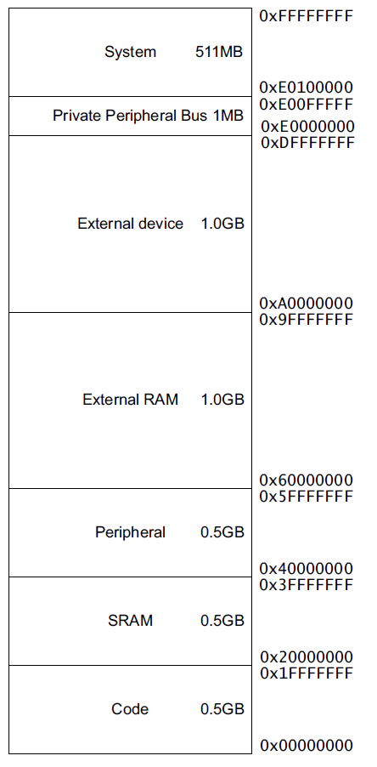
Memory Maps For Cortex M0+ and MCU
KL25Z128VLK4
0x2000_2FFF
16 KB SRAM
SRAM_U (3/4)
0x2000_0000
SRAM_L (1/4)
0x1FFF_F000
Some RAM is located in Code segment, allowing code to run from RAM to allow flash reprogramming or for better speed on faster systems
0x0001_FFFF
128KB Flash
0x0000_0000
Notes:
The ARM ISA has a 32-bit address space, allowing up to 2³² bytes of data to be addressed. This address space is divided into various regions for different uses. In the KL25Z128VLK4, 128 KB of Flash ROM is located in the bottom of the code memory at addresses 0x0000_0000 to 0x0001_FFFF. 16 KB of read/write memory (called SRAM, static RAM) is located straddling the Code and SRAM regions, from 0x1FFF_F000 to 0x1FFF_FFFF (Code region) and 0x2000_0000 to 0x2000_2FFF (SRAM region).
Additional space is reserved for other purposes, including peripherals and external RAM.

Slide 11
Endianness
 | Memory 0
Address A | B0 | LSB
A+1 | B1
A+2 | B2
A+3 | B3 | MSB
For a multi-byte value, in what order are the bytes stored?
Little-Endian: Start with least-significant byte
Big-Endian: Start with most-significant byte
Register
31 24 | 23 16 | 8 | 7 0
B3 | B2 | B1 | B0
 | Memory 0
Address A | B3 | MSB
A+1 | B2
A+2 | B1
A+3 | B0 | LSB
Register
31 24 | 23 16 | 8 | 7 0
B3 | B2 | B1 | B0
Notes:
When storing a multibyte value in memory, which end is stored first? The little end (LSB) or the big end (MSB)?

Slide 12
ARMv6-M Endianness
Instructions are always little-endian
Loads and stores to Private Peripheral Bus are always little-endian
Data: Depends on implementation, or from reset configuration
Kinetis processors are little-endian

Slide 13
Different Instruction Sets for Different Design Spaces?
ARM instructions optimized for resource-rich high-performance computing systems
Deeply pipelined processor, high clock rate, wide (e.g. 32-bit) memory bus
https://en.wikipedia.org/wiki/ARM_Cortex-M#Instruction_sets
Low-end embedded computing systems are different
Slower clock rates, shallow pipelines
Different cost factors – e.g. code size matters much more
Bit and byte operations critical

Slide 14
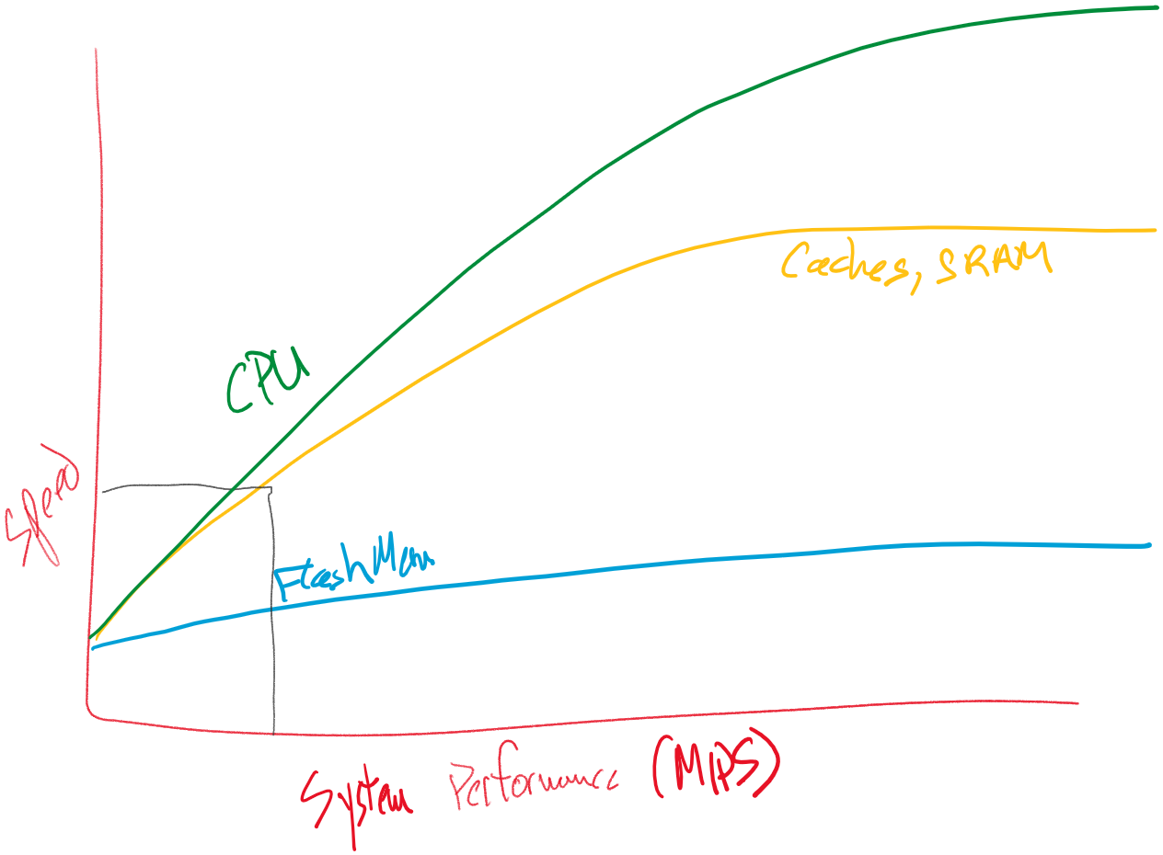
The Memory Wall
It has been easier to speed up the CPU than the memory
Facts of life
Off-chip memory is slower than on-chip memory. May not want to put all memory on-chip, even if possible.
Flash is slower to read or write than RAM.
Fast RAM is more expensive than slow RAM. Same for flash.
Design for high-performance CPUs
Use caches (small fast RAM) to make main memory (large slow RAM, flash) look faster at a low cost.
Put cache(s) on chip if possible.
Increase bandwidth by widening memory bus, improving protocol, reducing overhead, split transactions, using page mode, etc.)
Design for low-performance CPUs
Put memory on-chip with CPU. RAM, flash ROM
Increase flash ROM bandwidth by widening memory bus, adding prefetch buffer, branch target buffer, etc.
Add cache
Change instruction set size to reduce instruction bandwidth needed
Double flash bus width
Low Performance
High Performance

Slide 15
ARM and Thumb Instructions
Thumb technology reduces program memory size and bandwidth requirements
Thumb provides a subset of ARM 32-bit instructions re-encoded into usually fewer bits (most 16 bits, some 32 bits)
Not all 32-bit instructions available
Most 16-bit instructions can only access low registers (R0-R7), but a few can access high registers (R8-R15)
1995 :Thumb-1 instruction set
16-bit instructions
2003: Thumb-2 instruction set
Adds some 32 bit instructions
Improves speed with little memory overhead
CPU operating state
CPU decodes instructions based on whether in Thumb state or ARM state - controlled by T bit
Thumb state indicated by program counter being odd (LSB = 1)
Cortex-M0+ only uses Thumb instructions, is always in Thumb state
See ARMv6-M Architecture Reference Manual for specifics per instruction (Section A.6.7)

Slide 16
Cortex-M Instruction Groups
Group | Instr bits | Instructions | M0,M0+,M1 | M3 | M4 | M7 | M23 | M33,M35P
Thumb-1 | 16 | ADC, ADD, ADR, AND, ASR, B, BIC, BKPT, BLX, BX, CMN, CMP, CPS, EOR, LDM, LDR, LDRB, LDRH, LDRSB, LDRSH, LSL, LSR, MOV, MUL, MVN, NOP, ORR, POP, PUSH, REV, REV16, REVSH, ROR, RSB, SBC, SEV, STM, STR, STRB, STRH, SUB, SVC, SXTB, SXTH, TST, UXTB, UXTH, WFE, WFI, YIELD | Yes | Yes | Yes | Yes | Yes | Yes
Thumb-1 | 16 | CBNZ, CBZ | No | Yes | Yes | Yes | Yes | Yes
Thumb-1 | 16 | IT | No | Yes | Yes | Yes | No | Yes
Thumb-2 | 32 | BL, DMB, DSB, ISB, MRS, MSR | Yes | Yes | Yes | Yes | Yes | Yes
Thumb-2 | 32 | SDIV, UDIV | No | Yes | Yes | Yes | Yes | Yes
Thumb-2 | 32 | ADC, ADD, ADR, AND, ASR, B, BFC, BFI, BIC, CDP, CLREX, CLZ, CMN, CMP, DBG, EOR, LDC, LDM, LDR, LDRB, LDRBT, LDRD, LDREX, LDREXB, LDREXH, LDRH, LDRHT, LDRSB, LDRSBT, LDRSH, LDRSHT, LDRT, LSL, LSR, MCR, MCRR, MLA, MLS, MOV, MOVT, MRC, MRRC, MUL, MVN, NOP, ORN, ORR, PLD, PLDW, PLI, POP, PUSH, RBIT, REV, REV16, REVSH, ROR, RRX, RSB, SBC, SBFX, SEV, SMLAL, SMULL, SSAT, STC, STM, STR, STRB, STRBT, STRD, STREX, STREXB, STREXH, STRH, STRHT, STRT, SUB, SXTB, SXTH, TBB, TBH, TEQ, TST, UBFX, UMLAL, UMULL, USAT, UXTB, UXTH, WFE, WFI, YIELD | No | Yes | Yes | Yes | No | Yes
DSP | 32 | PKH, QADD, QADD16, QADD8, QASX, QDADD, QDSUB, QSAX, QSUB, QSUB16, QSUB8, SADD16, SADD8, SASX, SEL, SHADD16, SHADD8, SHASX, SHSAX, SHSUB16, SHSUB8, SMLABB, SMLABT, SMLATB, SMLATT, SMLAD, SMLALBB, SMLALBT, SMLALTB, SMLALTT, SMLALD, SMLAWB, SMLAWT, SMLSD, SMLSLD, SMMLA, SMMLS, SMMUL, SMUAD, SMULBB, SMULBT, SMULTT, SMULTB, SMULWT, SMULWB, SMUSD, SSAT16, SSAX, SSUB16, SSUB8, SXTAB, SXTAB16, SXTAH, SXTB16, UADD16, UADD8, UASX, UHADD16, UHADD8, UHASX, UHSAX, UHSUB16, UHSUB8, UMAAL, UQADD16, UQADD8, UQASX, UQSAX, UQSUB16, UQSUB8, USAD8, USADA8, USAT16, USAX, USUB16, USUB8, UXTAB, UXTAB16, UXTAH, UXTB16 | No | No | Yes | Yes | No | Optional
SP Float | 32 | VABS, VADD, VCMP, VCMPE, VCVT, VCVTR, VDIV, VLDM, VLDR, VMLA, VMLS, VMOV, VMRS, VMSR, VMUL, VNEG, VNMLA, VNMLS, VNMUL, VPOP, VPUSH, VSQRT, VSTM, VSTR, VSUB | No | No | Optional | Optional | No | Optional
DP Float | 32 | VCVTA, VCVTM, VCVTN, VCVTP, VMAXNM, VMINNM, VRINTA, VRINTM, VRINTN, VRINTP, VRINTR, VRINTX, VRINTZ, VSEL | No | No | No | Optional | No | No
TrustZone | 16 | BLXNS, BXNS | No | No | No | No | Optional | Optional
TrustZone | 32 | SG, TT, TTT, TTA, TTAT | No | No | No | No | Optional | Optional
Co-processor | 16 | CDP, CDP2, MCR, MCR2, MCRR, MCRR2, MRC, MRC2, MRRC, MRRC2 | No | No | No | No | No | Optional
https://en.wikipedia.org/wiki/ARM_Cortex-M#Instruction_sets

Slide 17
Reference for ARM Instruction Set Architecture
ARM V6-M Architecture Reference Manual, Chapter A5. The Thumb Instruction Set Encoding
16- or 32-bit instruction?
Bits [15:11]
0b11101, 0b1110, 0b11111: 32-bit instruction. Page A5-91
Else 16-bit instruction. Page A5-84

Slide 18
Example Instruction Encoding: ADC (register)
Page A6-106 of ARM-V6M ARM

Slide 19
Example Instruction Encoding: ADD (register)
Page A6-109 of ARM-V6M ARM

Slide 20
Assembler Instruction Format
<operation> <operand1> <operand2> <operand3>
There may be fewer operands
First operand is typically destination (<Rd>)
Other operands are sources (<Rn>, <Rm>)
Examples
ADDS <Rd>, <Rn>, <Rm>
Add registers: <Rd> = <Rn> + <Rm>
AND <Rdn>, <Rm>
Bitwise and: <Rdn> = <Rdn> & <Rm>
CMP <Rn>, <Rm>
Compare: Set condition flags based on result of computing <Rn> - <Rm>

Slide 21
Where Can the Operands Be Located?
In a general-purpose register R
Destination: Rd
Source: Rm, Rn
Both source and destination: Rdn
Target: Rt
Source for shift amount: Rs
An immediate value encoded in instruction word
In a condition code flag
In memory
Only for load, store, push and pop instructions

Slide 22
Update Condition Codes in APSR?
“S” suffix indicates the instruction updates APSR
ADD vs. ADDS
ADC vs. ADCS
SUB vs. SUBS
MOV vs. MOVS
Notes:
Some instructions have two variants: one which updates the condition codes (negative, zero, carry, overflow) and one which does not.

Slide 23
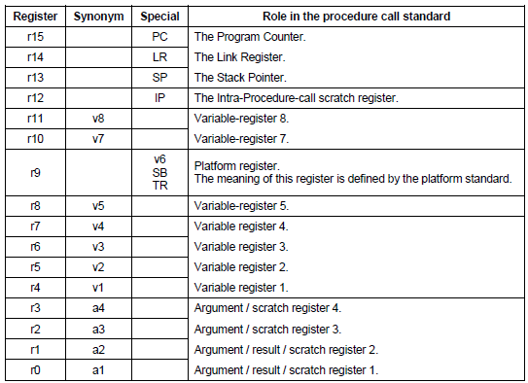
AAPCS Register Use Conventions
Arm Architecture Procedure Calling Standard (AAPCS): Makes it easier to create modular and isolated yet composable code
Preserved (“variable”) registers are expected to have their original values upon returning from a called subroutine
r4-r8, r10-r11
Scratch registers are not expected to be preserved upon returning from a called subroutine
r0-r3
Must be saved, restored by callee-procedure if it will modify them. Calling subroutine expects these to retain their value.
Must be saved, restored by callee-procedure if it will modify them.
Calling subroutine expects these to retain their value.
Don’t need to be saved. May be used for arguments, results, or temporary values.

Slide 24
Instruction Set Summary
Instruction Type | Instructions
Move | MOV
Load/Store | LDR, LDRB, LDRH, LDRSH, LDRSB, LDM, STR, STRB, STRH, STM
Add, Subtract, Multiply | ADD, ADDS, ADCS, ADR, SUB, SUBS, SBCS, RSBS, MULS
Compare | CMP, CMN
Logical | ANDS, EORS, ORRS, BICS, MVNS, TST
Shift and Rotate | LSLS, LSRS, ASRS, RORS
Stack | PUSH, POP
Conditional branch | B, BL, B{cond}, BX, BLX
Extend | SXTH, SXTB, UXTH, UXTB
Reverse | REV, REV16, REVSH
Processor State | SVC, CPSID, CPSIE, SETEND, BKPT
No Operation | NOP
Hint | SEV, WFE, WFI, YIELD
Barriers | DMB, DSB, ISB
Notes:
Here is a quick single-page summary of the available instructions. We will examine these in more detail next. The default data size is a 32-bit word, though there are some byte and halfword (16 bits) instructions available.

Slide 25
Load and Store Register Instructions
ARM is a load/store architecture, so must process data in registers (not memory)
LDR: load register with word (32 bits) from memory
LDR <Rt>, source address
STR: store register contents (32 bits) to memory
STR <Rt>, destination address
Source and destination addresses are specified using available addressing modes
Offset Addressing mode: [<Rn>, <offset>] accesses address <Rn>+<offset>
Base Register <Rn> can be R0-R7, SP or PC
<offset> is added or subtracted from base register to create effective address
Can be an immediate constant
Can be another register, used as index <Rm>
Auto-update: Can write effective address back to base register
Pre-indexing: use effective address to access memory, then update base register
Post-indexing: use base register to access memory, then update base register

Slide 26
Loading/Storing Smaller Data Sizes
 | Signed | Unsigned
Byte | LDRSB | LDRB
Half-word | LDRSH | LDRH
Some load and store instructions can handle half-word (16 bits) and byte (8 bits)
Store just writes to half-word or byte
STRH, STRB
Loading a byte or half-word requires padding or extension: What do we put in the upper bits of the register?
Example: How do we extend 0x80 into a full word?
Unsigned? Then 0x80 = 128, so zero-pad to extend to word 0x0000_0080 = 128
Signed? Then 0x80 = -128, so sign-extend to word 0xFFFF_FF80 = -128

Slide 27
In-Register Size Extension
 | Signed | Unsigned
Byte | SXTB | UXTB
Half-word | SXTH | UXTH
Can also extend byte or half-word already in a register
Signed or unsigned (zero-pad)
How do we extend 0x80 into a full word?
Unsigned? Then 0x80 = 128, so zero-pad to extend to word 0x0000_0080 = 128
Signed? Then 0x80 = -128, so sign-extend to word 0xFFFF_FF80 = -128

Slide 28
Load/Store Multiple
LDM/LDMIA: load multiple registers starting from [base register], update base register afterwards
LDM <Rn>!,<registers>
LDM <Rn>,<registers>
STM/STMIA: store multiple registers starting at [base register], update base register after
STM <Rn>!, <registers>
LDMIA and STMIA are pseudo-instructions, translated by assembler
Notes:
ARM also offers Load/Store Multiple instructions to reduce the amount of code needed and save time.

Slide 29
Load Literal Value into Register
Assembly pseudo-instruction: LDR <rd>, =value
Assembler generates code to load <rd> with value
Assembler selects best approach depending on value
Load immediate
MOV instruction provides 8-bit unsigned immediate operand (0-255)
Load and shift immediate values
Can use MOV, shift, rotate, sign extend instructions
Load from literal pool
1. Place value as a 32-bit literal in the program’s literal pool (table of literal values to be loaded into registers)
2. Use instruction LDR <rd>, [pc,#offset] where offset indicates position of literal relative to program counter value
Example formats for literal values (depends on compiler and toolchain used)
Decimal: 3909
Hexadecimal: 0xa7ee
Character: ‘A’
String: “44??”

Slide 30
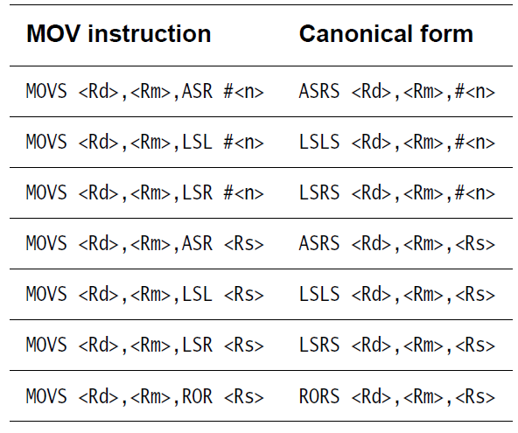
Move (Pseudo-)Instructions
Copy data from one register to another without updating condition flags
MOV <Rd>, <Rm>
Assembler translates pseudo- instructions into equivalent instructions (shifts, rotates)
Copy data from one register to another and update condition flags
MOVS <Rd>, <Rm>
Copy immediate literal value (0-255) into register and update condition flags
MOVS <Rd>, #<imm8>

Slide 31
Stack Operations
Push some or all of registers (R0-R7, LR) to stack
PUSH {<registers>}
Decrements SP by 4 bytes for each register saved
Pushing LR saves return address
PUSH {r1, r2, LR}
Largest register number pushed first (to largest address)
Pop some or all of registers (R0-R7, PC) from stack
POP {<registers>}
Increments SP by 4 bytes for each register restored
If PC is popped, then execution will branch to new PC value after this POP instruction (e.g. return address)
POP {r5, r6, r7}
Smallest register number popped first (from smallest address)

Slide 32
Add Instructions
Add registers, update condition flags
ADDS <Rd>,<Rn>,<Rm>
Add registers and carry bit, update condition flags
ADCS <Rdn>,<Rm>
Add registers
ADD <Rdn>,<Rm>
Add immediate value to register
ADDS <Rd>,<Rn>,#<imm3>
ADDS <Rdn>,#<imm8>
Notes:
Recall that the S suffix indicates that the status registers should be updated.

Slide 33
Add Instructions with Stack Pointer
Add SP and immediate value
ADD <Rd>,SP,#<imm8>
ADD SP,SP,#<imm7>
Add SP value to register
ADD <Rdm>, SP, <Rdm>
ADD SP,<Rm>

Slide 34
Address to Register Pseudo-Instruction
Add immediate value to PC, write result in register
ADR <Rd>,<label>
How is this used?
Enables storage of constant data near program counter
First, load register R2 with address of const_data
ADR R2, const_data
Second, load const_data into R2
LDR R2, [R2]
Value must be close to current PC value
Notes:
Sometimes a program may need to move a certain address (near the program counter) into a register. The ADR pseudo-instruction tells the assembler to do this, allowing it to determine the best way to do it.

Slide 35
Subtract
Subtract immediate from register, update condition flags
SUBS <Rd>,<Rn>,#<imm3>
SUBS <Rdn>,#<imm8>
Subtract registers, update condition flags
SUBS <Rd>,<Rn>,<Rm>
Subtract registers with carry, update condition flags
SBCS <Rdn>,<Rm>
Subtract immediate from SP
SUB SP,SP,#<imm7>
Notes:
Recall that the S suffix indicates that the status registers should be updated.

Slide 36
Multiply
Multiply source registers, save lower word of result in destination register, update condition flags
MULS <Rdm>, <Rn>, <Rdm>
<Rdm> = <Rdm> * <Rn>
Signed multiply
Note: upper word of result is truncated

Slide 37
Logical Operations
Bitwise AND registers, update condition flags
ANDS <Rdn>,<Rm>
Bitwise OR registers, update condition flags
ORRS <Rdn>,<Rm>
Bitwise Exclusive OR registers, update condition flags
EORS <Rdn>,<Rm>
Bitwise AND register and complement of second register, update condition flags
BICS <Rdn>,<Rm>
Move inverse of register value to destination, update condition flags
MVNS <Rd>,<Rm>
Update condition flags by ANDing two registers, discarding result
TST <Rn>, <Rm>
Notes:
All of these instructions update the status registers.

Slide 38
Compare
Compare - subtracts second value from first, discards result, updates APSR
CMP <Rn>,#<imm8>
CMP <Rn>,<Rm>
Compare negative - adds two values, updates APSR, discards result
CMN <Rn>,<Rm>

Slide 39
Shift and Rotate
Common features
All of these instructions update APSR condition flags
Shift/rotate amount (in number of bits) specified by last operand
Logical shift left - shifts in zeroes on right
LSLS <Rd>,<Rm>,#<imm5>
LSLS <Rdn>,<Rm>
Logical shift right - shifts in zeroes on left
LSRS <Rd>,<Rm>,#<imm5>
LSRS <Rdn>,<Rm>
Arithmetic shift right - shifts in copies of sign bit on left (to maintain arithmetic sign)
ASRS <Rd>,<Rm>,#<imm5>
Rotate right
RORS <Rdn>,<Rm>

Slide 40
Reversing Bytes
MSB
LSB
REV - reverse all bytes in word
REV <Rd>,<Rm>
REV16 - reverse bytes in both half-words
REV16 <Rd>,<Rm>
REVSH - reverse bytes in low half-word (signed) and sign-extend
REVSH <Rd>,<Rm>
MSB
LSB
MSB
LSB
MSB
LSB
MSB
LSB
Sign extend
MSB
LSB
Notes:
Byte and halfword reversing are sometimes needed when switching between little-endian and big-endian representations. File and network data packet formats may have fields with different endianness.

Slide 41
Changing Program Flow - Branches
Unconditional Branches
B <label>
Target address must be within 2 KB of branch instruction (-2048 B to +2046 B)
Conditional Branches
B<cond> <label>
<cond> is condition - see next page
B<cond> target address must be within of branch instruction
B target address must be within 256 B of branch instruction (-256 B to +254 B)

Slide 42
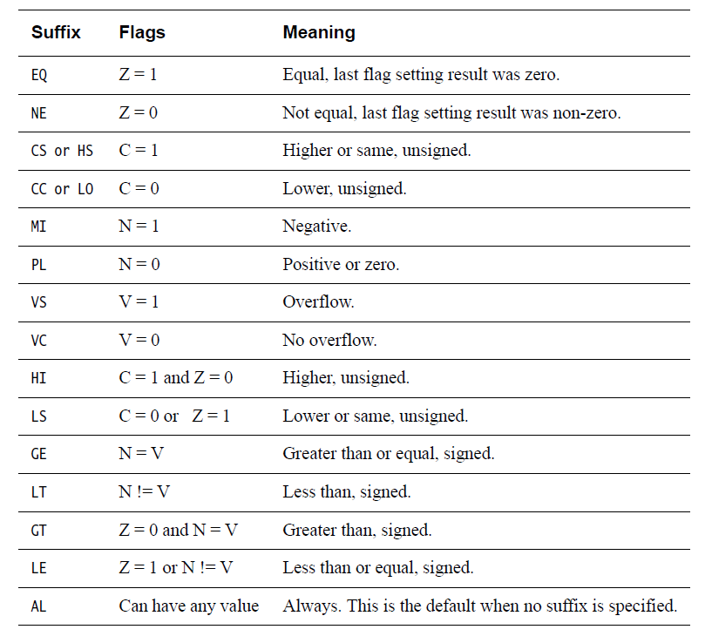
Condition Codes
Append to branch instruction (B) to make a conditional branch
Full ARM instructions (not Thumb or Thumb-2) support conditional execution of arbitrary instructions
Note: Carry bit = not-borrow for compares and subtractions

Slide 43
Changing Program Flow - Subroutines
Call
BL <label> - branch with link
Call subroutine at <label>
PC-relative, range limited to PC+/-16MB
Save return address in LR
BLX <Rd> - branch with link and exchange
Call subroutine at address in register Rd (exchange Rd with PC)
Supports full 4GB address range
LSB of target address must be set to 1 to ensure continued execution in Thumb state
Save return address in LR
Return
BX <Rd> branch and exchange
Branch to address specified by <Rd>
LSB of target address must be set to 1 to ensure continued execution in Thumb state
Supports full 4 GB address space
BX LR - Return from subroutine
POP {PC}
Notes:
These instructions with X (exchange) allow interworking – switching between ARM and Thumb modes. However, the Cortex-M0+ only supports Thumb mode, so don’t try to switch to ARM mode.

Slide 44
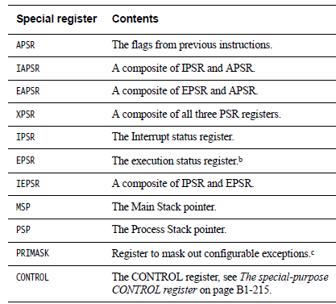
Special Register Instructions
Move to Register from Special Register
MSR <Rd>, <spec_reg>
Move to Special Register from Register
MRS <spec_reg>, <Rd>
Change Processor State - Modify PRIMASK register
CPSIE - Interrupt enable
CPSID - Interrupt disable

Slide 45
Other
No Operation - does nothing! Used for delays, or to align instruction to word address
NOP
Breakpoint - causes hard fault or debug halt - used to implement software breakpoints
BKPT #<imm8>
Wait for interrupt - Pause program, enter low-power state until a WFI wake-up event occurs (e.g. an interrupt)
WFI
Supervisor call generates SVC exception (#11), same as software interrupt
SVC #<imm>

